Slide 1


Slide 2
Some facts around the world…
Russian authorities put ban on ‘emo’ culture. The anti-emo culture promotes depression, social withdrawal.
Mexicans celebrate New Years eve by eating 12 grapes at the stroke of midnight.
In Denmark, citizens have to select baby names from a list of government approved names.
In Malaysia, the authorities prohibited its people from wearing yellow clothing. As yellow was worn by protestors.
In Singapore, importing, selling and spitting of chewing gum will result in a steep fine.
In France, its legal to marry a dead, provided one is able to prove that both were in love.
Indians believe that a boy takes the family name ahead and female infanticide takes place in urban area rather than rural.

Slide 3

Sociology and Nature of Sociology
FYBMM- INTRODUCTION TO SOCIOLOGY

Slide 4

Sociology
Scientific study of human society, it’s origin, structure, function, and direction
The word Sociology was taken from two foreign words:
      Socius a Latin term which means companion or associate
      Logos a Greek term for study

Slide 5
definition
Sociology is the systematic study of human society and social interaction.
A society- it is a large social grouping that shares the same geographical territory and is subject to the same political authority and dominant cultural experience.
It is an ability to see the relationship between individual experiences and the larger society- social imagination.

Slide 6


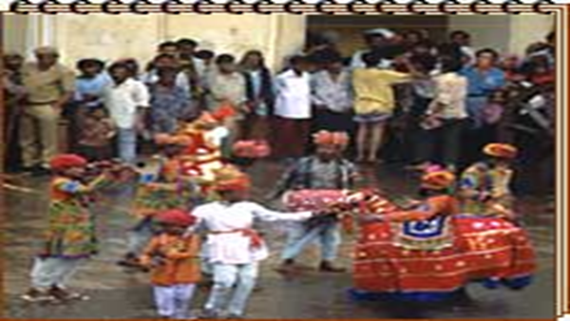

DEFINTION- IT IS A STUDY OF…
ASSOCIATION
GROUP
SOCIETY AND
SOCIAL INTERACTION

Slide 7

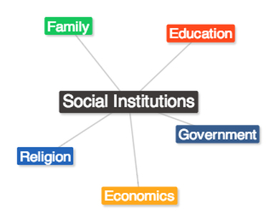
Sociology focuses on…
How social relationships influences people’s attitude and behavior
How major social institutions affect us
How we affect other individuals, groups and organizations

Slide 8
The sociological perspective
It helps us to see general social patterns in the behavior of particular individuals.
It allows or forces us to look beyond the outer appearances of our social world and discover new levels of reality
It encourages us to realize that society guides our thoughts and deeds- to see the strange in the familiar.
Sociology also encourages to see individuality in social context.

Slide 9

Characteristics of Sociology
1. Sociology is an independent science. A systematic study of anything that can be examined, tested, and verified.
2. It is abstract not concrete.
3. It is Neutral- ethically neutral and maintains a value-free position. (moral judgements and values, and overcome personal biases, and their teaching)
4. Sociology is rational and experimental.
5. Sociology is generalizing not individualizing.
6. Sociology is categorical not a normative. ( deriving from a standard or norm, especially of behavior.)
7. It is concerned with the study of human social life.

Slide 10
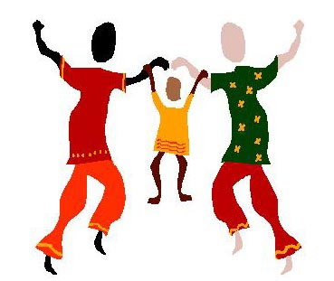
The Sociological Perspective
One of the major goals of this perspective is to identify underlying, recurring patterns of influences on social behavior. The sociological perspective goes beyond identifying patterns of social behavior; it also attempts to provide explanations for such patterns.

Slide 11

Distinctive Characteristics of Sociology
Pure science. As a pure science, it aims to provide knowledge about human society, not the utilization of that knowledge.
Categorical discipline. As categorical discipline, it is a body of knowledge about human society, and not a system of ideas and values.
Synthesizing science. As synthesizing science, it tends to come up with certain generalizations about human interaction and association, about the nature, form, content and structure of human groups and societies

Slide 12

Sociological Approaches,
Methods, and Research
Sociology started when people first began to make observations about each other’s behavior.
Sociology as a science is a body of organized, verified knowledge which has been secured through scientific investigation.
Sociology, as a science, rejects myth, hearsay, folklore, and wishful thinking and bases its inclusion on empirical (experimental) evidence.
All natural phenomena can be studied scientifically, if we use the scientific approaches. Any kind of behavior affecting the environment can be a subject for scientific approaches.

Slide 13
Importance of sociology
1. Factual information from research will better understand our society and other societies.
understanding
Broad-minded
Tolerant
2. Learn the application of scientific methods and techniques to our daily life problems.
3. It enables us to see the connection between our personal experiences and the social forces in the bigger social world daily which influences life.

Slide 14

Continue…
4. It furnishes interested people and specialized sciences with principles and scientific data which they can use in their work.
5. It provides insights into the interrelationship of human beings within the group so that we may live in harmony with others.
6. The results of sociological investigations provide a better background for meeting and solving problems.

Slide 15

Continue…
7. The results of inquiry can help dispel popular myths, superstitions and stereotypes with accurate knowledge about human behavior and human societies.
8. It broadens our experience as we learn to discard our prejudices and biases as we become more understanding and tolerant (accepting) of the customs of other people.
9. Results of sociological investigations are useful to government officials, community leaders, entrepreneurs, businessmen, etc.

Slide 16

o Gender and ethnicity: The posture of the women versus the men, the positioning in the ad of the Whites (center and top) and the Blacks, noting the dominant posture of the man in the white shirt in the middle
o

Slide 17
Examples of different societies and interpretations
For e.g. India, Domino Pizza stresses its fast delivery to differentiate itself from its competitors.
In Britain, customers don’t like the idea of home delivery.
In Japan, houses are not numbered sequentially, so finding an address becomes difficult.
In Iceland many don’t have phones.

Slide 18
Examples…
Pillsbury marketed canned sweet corn because it felt that sweet corn would not require any flavour changes across international markets.
But to its surprise, adjustments had to be made, not in its flavour but how it had to be positioned.
The French add it to salad and eat it cold;
In UK, it is a sandwich filler and pasta topping.
In Japan, children have it as an after school snack.
In Korea, it is sprinkled on ice cream.
Advertising in the European Common Market is not easy as one would think. Children’s clothes are not popular in France where children are dressed as small adults.
In Southern Europe, form-fitting clothes sell well but not in Netherlands where they lose clothing.

Slide 19
Gender roles…
In East Africa and in parts of West Africa (Nigeria) the role of women in business is crucial and more important than the role of men. However men still hold an important decision-making role when it comes to major sales or purchase decisions
In India and Pakistan women share responsibility with men in business. Women play a more limited role politically where a few hold notable positions, despite women leaders who have left important legacies in these countries.
In most traditional Islamic countries, women’s business activities are channelled toward interaction in a women-only environment.
In Saudi Arabia women depend on men in the family for simple activities, such as driving them to and from a destination; the law does not permit women to drive a car. Personal services can be performed only by individuals of the same gender. E.g. women can bank only at women’s bank , can have their hair done only by other women. The genders typically do not interact in the very traditional Islamic countries except within the family.
Even in less traditional Islamic countries women are seated separately from men. In countries such as Turkey and Pakistan women have historically held prominent government positions.
In Saudi Arabia women cannot be portrayed in ads. It is appropriate to show the covered arms and wrists of a woman demonstrating a product use. In Malaysia , women should not be shown sleeveless,

Slide 20
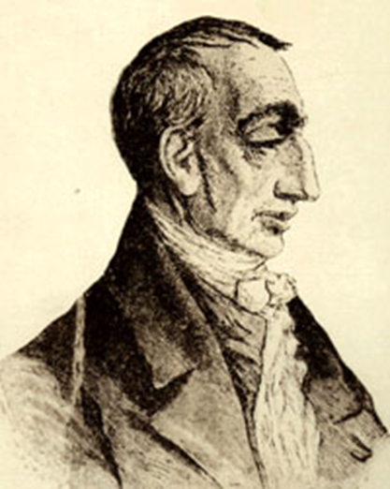
Pioneers/forerunners of sociology
1. Wrote his ideas about society based on the assumption that the law of human behavior could be determined in the manner that the law of nature had been arrived at by natural scientist.
Henri saint-simon (1760-1825)

Slide 21
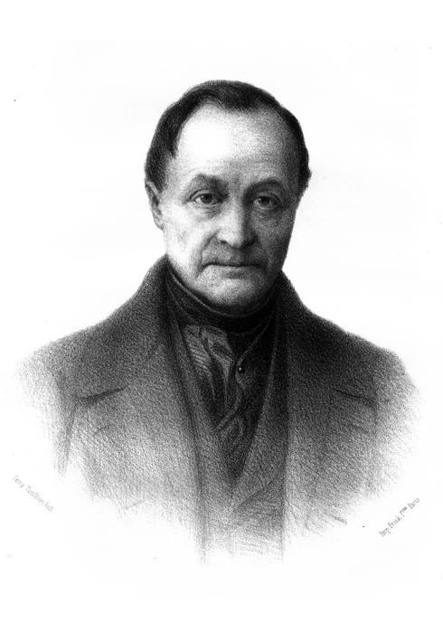
AUGUSTE COMTE (1798-1857)
A French philosopher who developed positive philosophy in an attempt to remedy the social malaise of French Revolution.
His social theories culminated in his religion of humanity which presaged the development of non-theistic religious humanist and secular humanist organizations in the 19th century. He coined the term ‘altruism’.

Slide 22
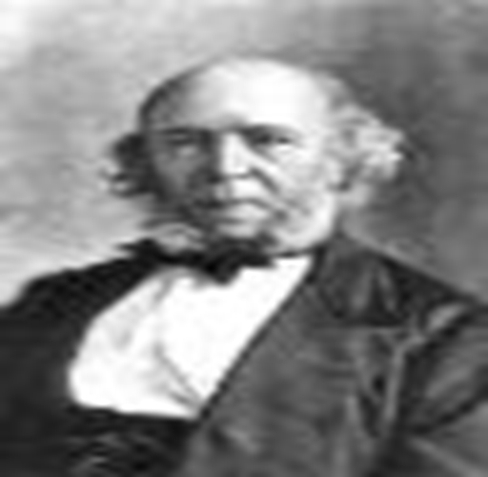
HERBERT SPENCER – (1830-1903)
3. British philosopher-scientist who argued the idea of “positivism or the use of empirical (experimental) investigation to understand society and social phenomenon.

Slide 23
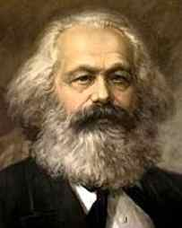
KARL MARX (1818-1883)
4. A German philosopher who believed that the misery and exploitation of the working lower classes in society was caused by capitalism-the existing industrial order.

Slide 24
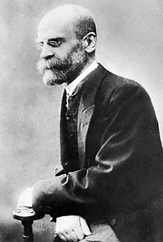
EMILE DURKHEIM (1858-1917)
5. A French sociologist who focused on the characteristics of social groups, particularly the cohesion or non- cohesion of religious groups. * Study suicide rates in Catholics and protestants.

Slide 25

RELATIONSHIP OF SOCIOLOGY TO THE OTHER SCIENCES
1. SOCIOLOGY AND ECONOMICS.
A great deal of human social behavior is economically motivated.
The desire for economic gains and possession of material wealth are strong motivating forces for human behavior.

Slide 26


2. ANTHROPOLOGY-
ANTHROPOLOGY IS THE SCIENCE WHICH STUDIES MAN BOTH AS ANIMAL AND AS LIVING IN SOCIETY, HIS ORIGINS, DEVELOPMENT, DISTRIBUTION SOCIAL HABITS AND CULTURES.
3. HISTORY-
SOCIOLOGY MAKES USE OF DATA AND PIECES OF INFORMATION THAT ARE PROVIDED BY HISTORIANS IN ORDER TO FORM CERTAIN GENERALIZATIONS ABOUT SOCIETY AND SOCIAL INTERACTIONS.

Slide 27

Psychology
PSYCHOLOGY IS INTERESTED IN THE STUDY OF WHAT GOES ON “WITHIN” THE INDIVIDUAL, HIS INNER NEEDS, DRIVES, INTERESTS, INTELLIGENCE, MOTIVES, HOPES AND FEARS. SOCIOLOGY IS CONCERNED WITH THE STUDY OF “WHAT GOES ON AMONG AND BETWEEN” PEOPLE, HIS SOCIAL INTERACTIONS , SOCIAL STRUCTURE, VALUES, CUSTOMS, LAWS, MORALS, ETC.

Slide 28
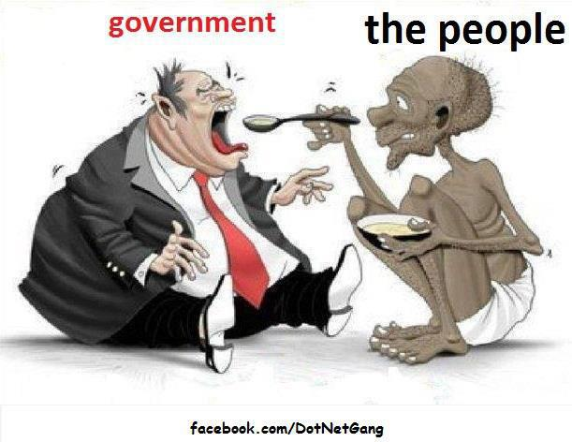
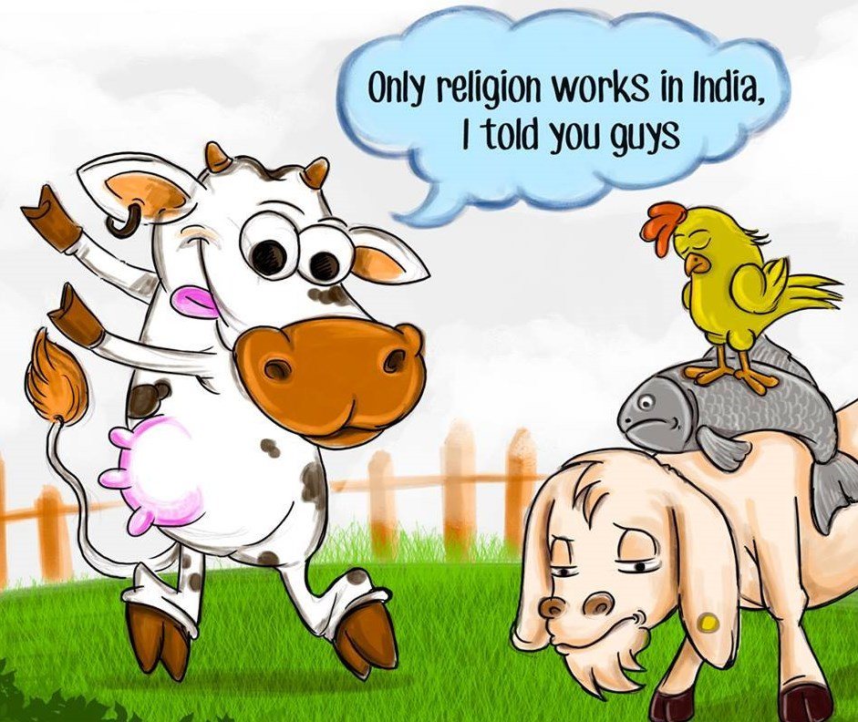
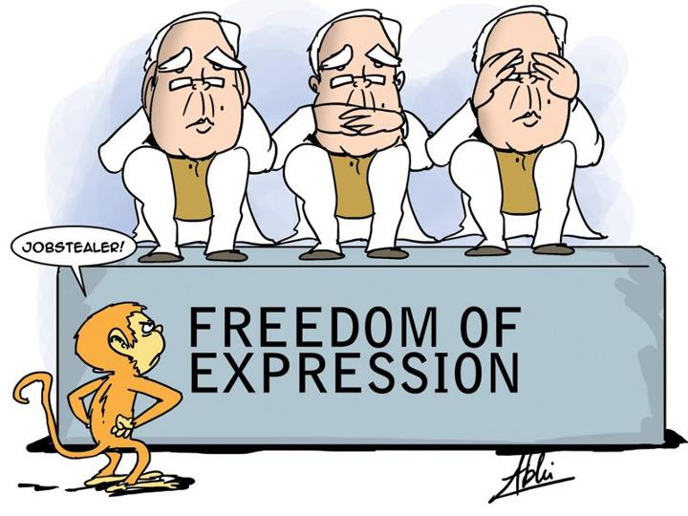
Political science
SOCIOLOGISTS ARE INTERESTED IN THE STUDY OF THE SOCIAL INTERACTIONS INVOLVED IN HUMAN POLITICAL ACTIVITIES, THE DISTRIBUTION OF POWER IN THE SOCIETY, THE FORMATION OF POLITICAL DYNASTIES, AND THE ROLE OF WOMEN AND ETHNIC GROUPS IN POLITICAL EVENTS.

Slide 29
Sociological Approaches
The Evolutionary Approach – the earliest theoretical approach was based on the work of Auguste Comte and Herbert Spencer. This approach seemed to offer a satisfying explanation of how human groups come to exist, grow, and develop. Sociologist using this approach as a frame of reference look for patterns of change.
The Interactionist Approach – suggests no grand theories of society since society and social and political institutions are conceptual abstractions , and only people and their interactions can be studied directly.

Slide 30
Sociological Approaches
The Functionalist Approach – views society as an organized network of cooperating groups operating orderly according to generally accepted norms.
The Conflict Approach – view society as one that is held together through the power of dominant groups. These theorist claim that the “share values” of functionalists do not really exist, an artificial consensus in which dominant groups or classes impose these values and rules upon the rest of the people.

Slide 31
Assignment
Study the society in which you live.
Study the culture, thought process of the people
Understanding, tolerant…
How do they gather knowledge
Association,
How they behave towards certain myths, and how they react towards it.
Work in a group…

Slide 32

Easy hai na…

